Slide 1

CMC Partners AS
Crazy, but Right for All in Time
www.cmca.no
www.cmc.tips
www.Tjugum.info
Notes:
noske selskaper invester I land me lempliger klima-krav jfr Nordfond , Scatex.com etc
As always , ahead of all
Crazy, but Right for All in time
www.cmca.no
www.cmc.tips
www.Tjugum.info

Slide 2
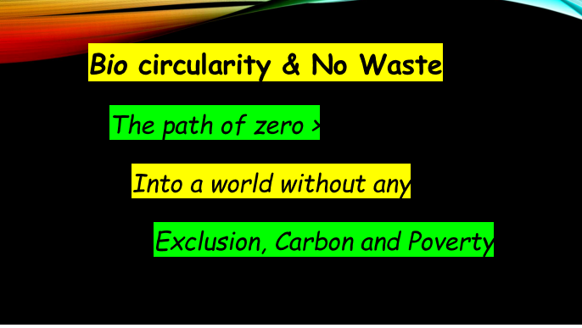


Sustainable Construction Solution
Decarbonized & No-waste Concrete application
BioM -Silica
For
Cement Replacement & Durability Improving >> Concrete Structure
Notes:
'image: Flaticon.com'. This cover has been designed using images from Flaticon.com; designer: Eucalyp

Slide 3
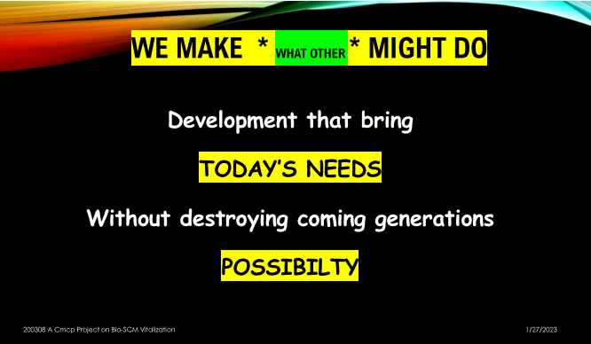

Slide 4

Background
Chemical Engineer with 40 years creating high quality and durable concrete Structures
Technical Consultant on cement technology, making innovative and advanced formulation
Involved in producing renewable bio-energy and bio-fertilizers in farming
Pioneered the use of FeM-Silica, captured ferro silica fume (waste), for replacement of cement in concrete structures
Odd Magnus Tjugum
President
Notes:
http://www.tjugum.info/about

Slide 5
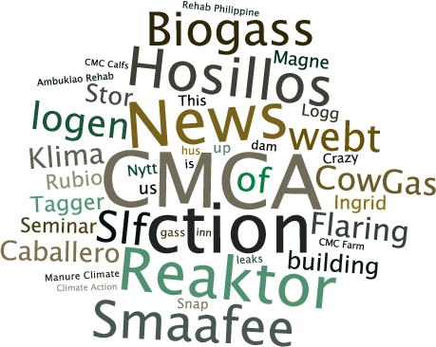
Background
Operates primarily in the Scandinavian region
“CMC” stands for “Crazy Mens Club” = Crazy, but Right in Time for All
Advocates decarbonized and no-waste concrete application; and environment-friendly construction solutions
Has reliable technical expertise to make high durability replacement of cement; and verified knowledge out of decades of experience
Projects worked on:
  Ambuklao Dam, SN Aboitiz Power, Philippines
  LNG tank constructions at Isle of GRAIN, UK
  Adriatic LNG Terminal Project in Spain, concrete work in Madrid
  Snøhvit, LNG tank construction ; Statoil, Hammerfest
  Øresund Tunnel Contractors, Copenhagen, sub sea tunnel construction
  Several Offshore platforms built by Norwegian contractors
  Ekofisk Protective Barrier
About
CMC Partners AS
Notes:
http://www.tjugum.info/about

Slide 6
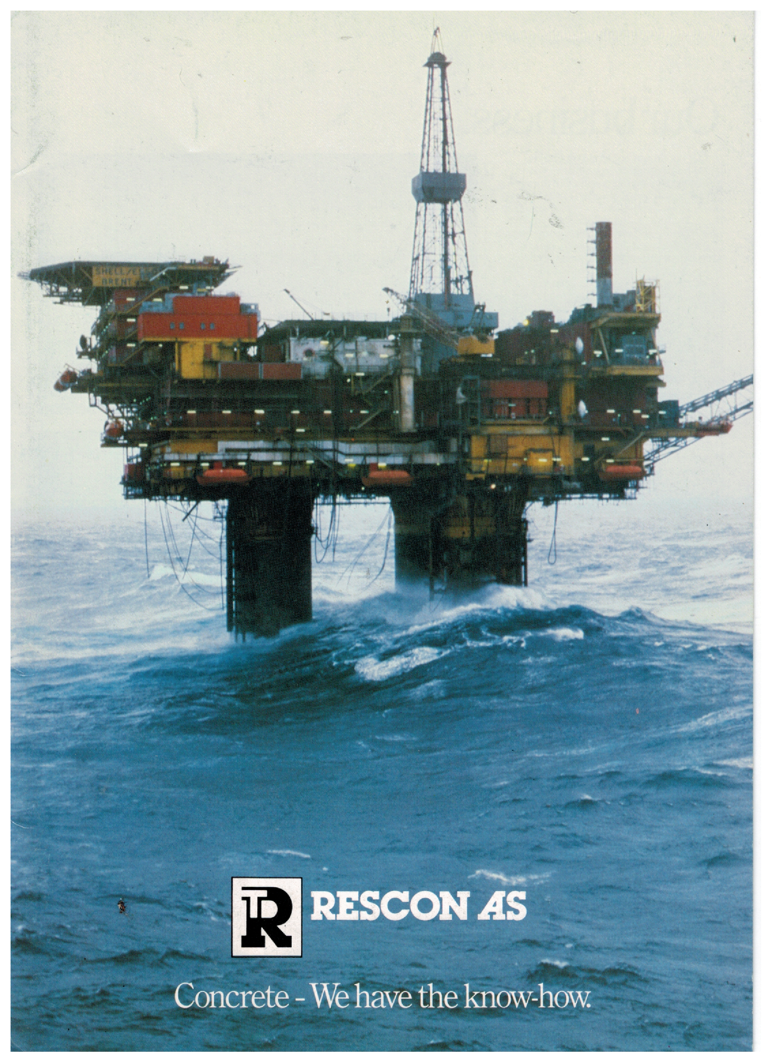
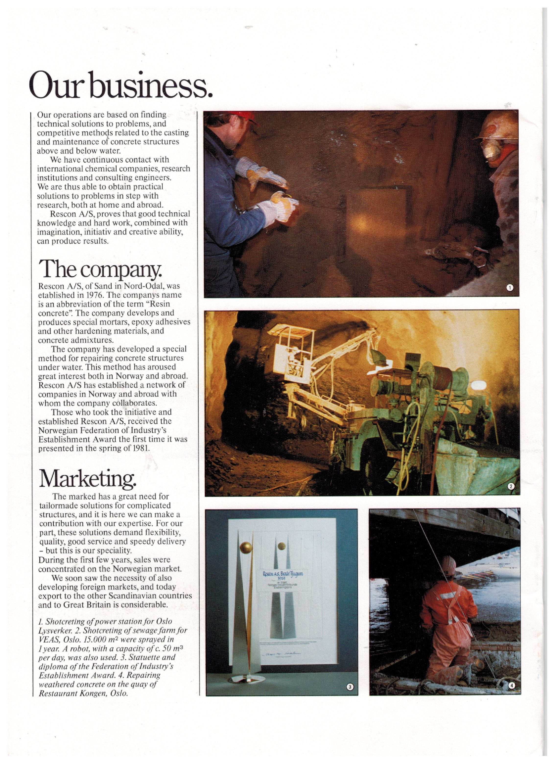
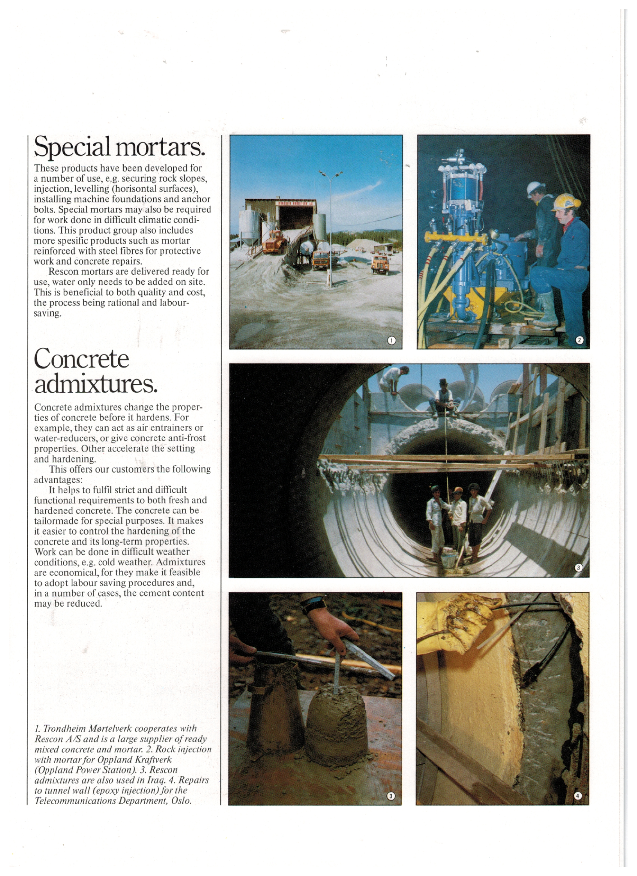

Slide 7

Objectives
Advocating sustainable construction solutions by promoting a circular economy model in the use of farm waste (i.e., rice husk) for renewable bio-energy, and using the ash as construction material.
Partnering with companies and institutions to join in this climate action initiative and promote decarbonized and no-waste concrete application.

Slide 8




Slide 9
The need for SUSTAINABILITY
Rapid increasing population and global economic growth
has led to increased consumption and an unsustainable high level of emissions
Emissions = Climate Change

Slide 10
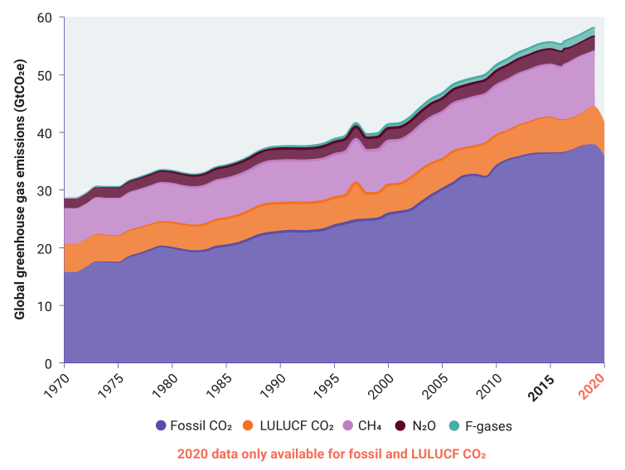
The need for SUSTAINABILITY
Cement production account for around 8% of CO₂ emissions
“The material that built the modern world is also destroying it.”
Emissions = Climate Change
Image source: (UNEP, 2021)
Notes:
According to Chatham House (2018), https://www.chathamhouse.org/2018/06/making-concrete-change-innovation-low-carbon-cement-and-concrete

Slide 11
The need for SUSTAINABILITY
Required sustainability
  is not just about the environment
The Securities and Exchange Commission (SEC) will
  increasingly require companies to submit Sustainability Reports
Government thrust to address climate change,
  encouraging sustainability among companies
The public are increasingly expecting companies
  to be sustainable and environmentally responsible

Slide 12
Public’s demand for sustainability
There was a 71% rise in online searches for
  sustainable goods globally over the past five years.
Not just in high-income countries,
  but is also strong in developing and emerging economies.
In one survey, 66% of all respondents said
  they consider sustainability when making a purchase.
  Customers switch products or services when a company violates their values.
Dentsu Consumer Vision 2021:
  consumers have a growing concern on the environmental impact
  of businesses and their response to climate change
Notes:
https://www.weforum.org/agenda/2021/05/eco-wakening-consumers-driving-sustainability/
https://brands.dentsu.com/consumer-vision-2030/start

Slide 13
Our Proposal: BioM-Silica replace content of cement
BioM-Silica mostly rice husk ash
contains 85% to 95% amorphous silica, a highly active pozzolanic, used for making high quality concrete structures
requires less energy for production, negative carbon footprint
come from renewable resource without toxic components
mostly dumped as Bio-waste ( ca 2 million m/tons in 2016)
turn farm waste to infrastructure circularity
increasing farmers’ income through innovation and development
Sustainable Construction Solution
Notes:
https://www.researchgate.net/publication/350823893_CO2_EMISSION_ASSESSMENT_FOR_RICE_HUSK_ASH_IN_CONCRETE_ON_ENVIRONMENTAL_APPROACH
https://sciendo.com/pdf/10.2478/ncr-2018-0014#:~:text=RHA%20is%20a%20cheap%20waste,higher%20value%20for%20alternative%20use.&text=RHA%20requires%20less%20energy%20than,materials%20reduces%20the%20carbon%20footprint.&text=Optimizing%20RHA%20as%20a%20SCM,disposal%20of%20wastes%20onto%20land.
2 MMT rice husk - https://www.philstar.com/business/agriculture/2016/11/27/1645845/government-promotes-rice-husk-alternative-energy-source

Slide 14
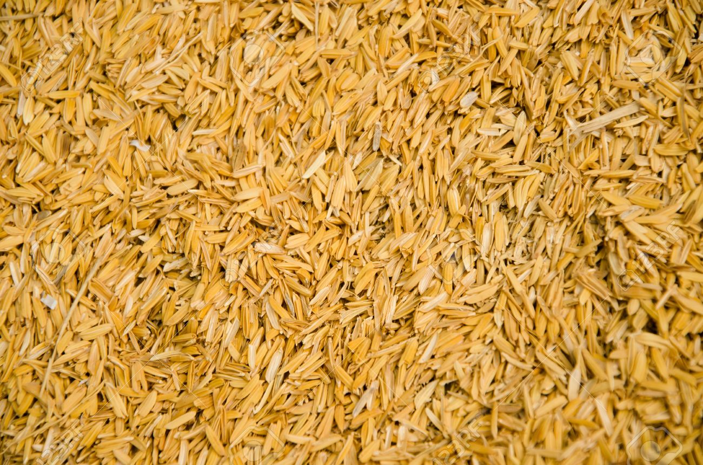
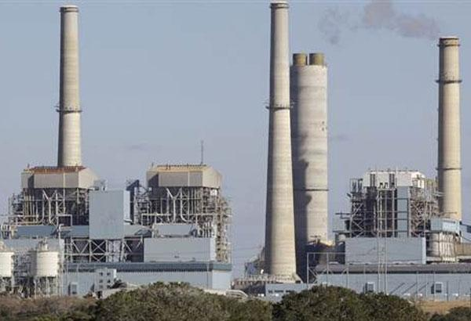

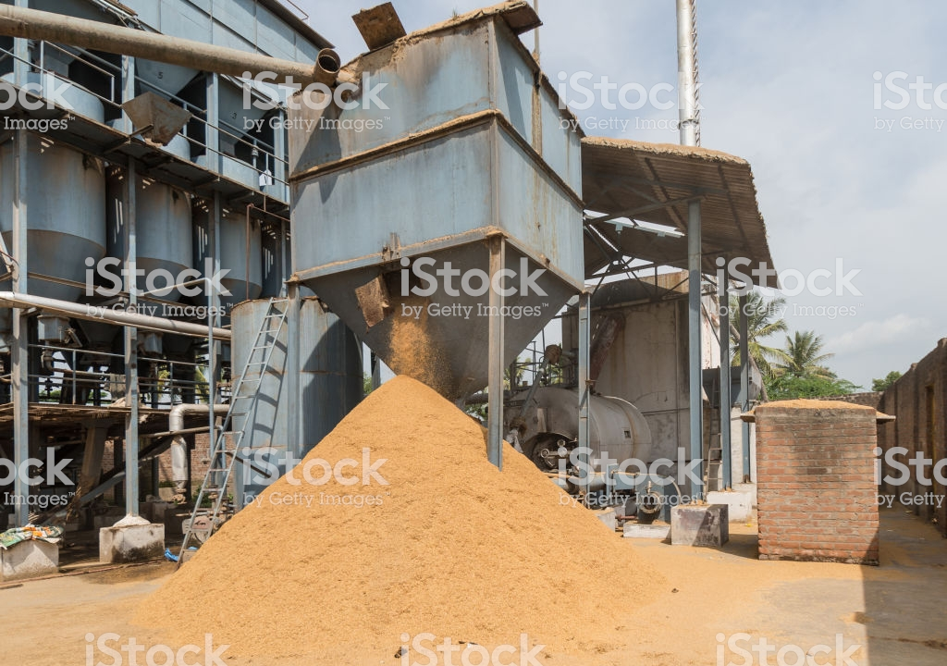

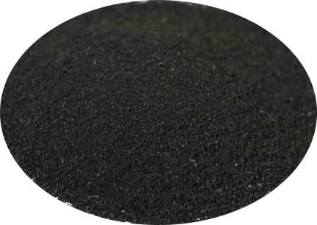
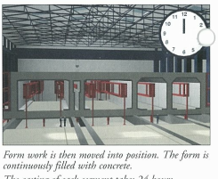
Agriculture no waste value chain
Bio Micro Silica
Agriculture chain supply
Food – Energy – Construction
Realities of Sustainable, Renewable, Green, Biological Innovations
Rice Husk
Biomass Power Plant
Rice Mill
Rice Farm
Bio Micro Silica
(rice husk ash)

Slide 15
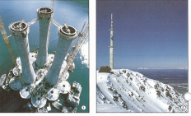
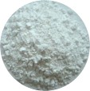

Technical discussion on Bio Micro Silica Concrete
Amorphous Silica
Recovery 88% wt.
Pyrolysis Char
Rice Husk
Pyrolysis 500 °C
Spouted bed
Bio Micro Silica
Silica extraction
HCI and Na₂CO₃
Micro Silica Concrete
Steam activation
500 °C
26% wt.
BET surface area
1365 m² g⁻¹
Gas
6% wt.
Bio-oil
68% wt.
Activated Carbon
Notes:
Overall valorization of rice husk char obtained by flash pyrolysis in a conical spouted bed reactor (CSBR) has been studied in a two-step process
Silica has been recovered in a first step and the remaining carbon material has been subjected to steam activation
Char samples used in this study have been obtained by continuous flash pyrolysis in a conical spouted bed reactor at 500 °C.
Extraction with Na2CO3 allows recovering 88% of the silica contained in the rice husk char.
Activation of the silica-free rice husk char has been carried out in a fixed bed reactor at 800 °C using steam as activating agent.
The porous structure of the activated carbons produced includes a combination of micropores and mesopores, with a BET surface area of up to 1365 m² g⁻¹ at the end of 15 min.

Slide 16
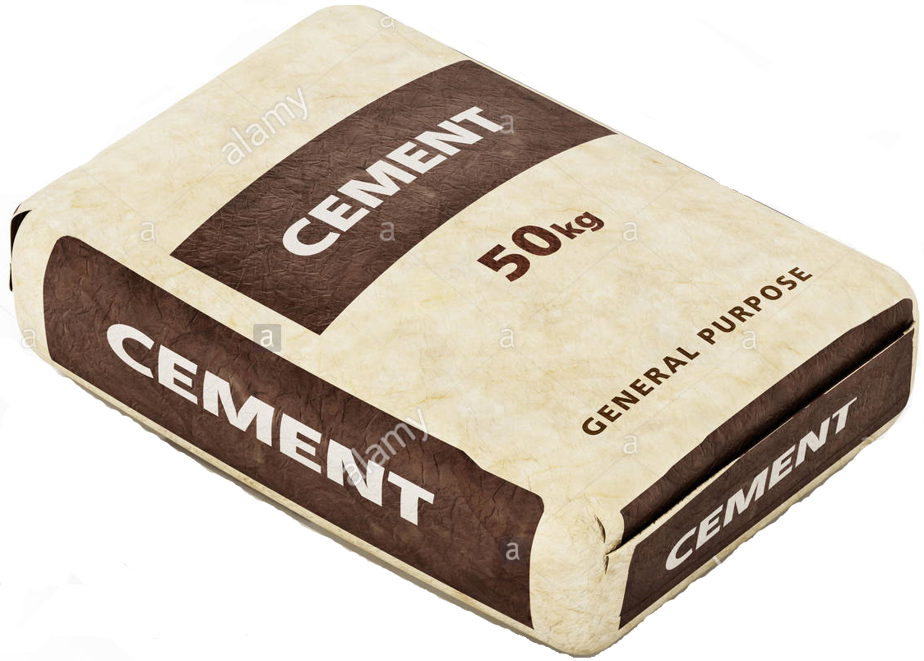
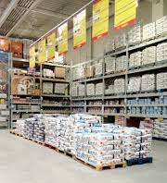
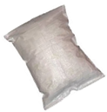
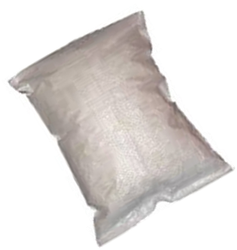
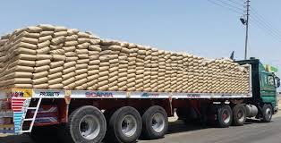
Potential benefits
=
5 kg.
Bio Micro Silica
30-40 kg. conventional cement
Less packaging cost
Less warehouse cost
Less transport cost

Slide 17
Service Offering: Technical Consulting Services and Research Contribution
Assess the utility of BioM-Silica as a highly
  efficient and sustainable cement replacement material
Apply new techniques and processes
  utilizing renewable and biological raw-materials
Pursue product development
  research and business development activities
Sourcing Bio Micro Silica in the Philippines

Slide 18
Sustainable Construction Solution
Sustainable and Durable, Concrete and Structures
\CMC Partners AS
Notes:
'image: Flaticon.com'. This cover has been designed using images from Flaticon.com; designer: Eucalyp

Slide 19
The Path of Zero in Philippine Concrete Structures
SINTEF Byggforsk Norway harald.justnes@sintef.no
Mobil +47 930 58 688 / https://www.sintef.no/byggforsk
The reliable path of concrete with less CO₂ emission
is to replace the cement.
The most common CRM - Cement Replacement Materials are
              blast furnace slag from iron production,
              fly ash from coal burning energy plants
              FeM-Silica from ferro silicon smelters.
But all these CRMs are politically defined , only
as not being associated with CO₂-emission even though they
are from heavily polluting industries.

Slide 20
BioM-Silica of huge quantity in Asia
- is less kown being in common use
The CO₂-emission when burning the Bio-Fuel for energy purpose
is by nature zero
as the same amount of CO₂ was drawn from the air by the plants
This means replacing 20% of any cement in concrete
reduces close to 20% of the carbon-footprint of that concrete
since the cement is by far the dominating source of CO₂-emission
> >>>>
90% compared to the other constituents like natural aggregate and water

Slide 21
Depending how the BioM - Silica is burnt
it contain beneficial fraction of pure carbon
This carbon is taken out of the atmosphere and stored permanently in the concrete.
So, replacing cement with Bio Micro Silica will be
below zero - in terms CO₂-emission, in fact negative.
BioM- Silica has a very high content of amorphous silica with a high surface
>> rendering it highly potent as an CRM
in terms of increased workability, strength and improved durability
> relative to the cement it replaces.
The benefical effect of BioM - Silica on concrete properties
is well documented in world-wide scientific journal publications
>> and is safe to use.

Slide 22
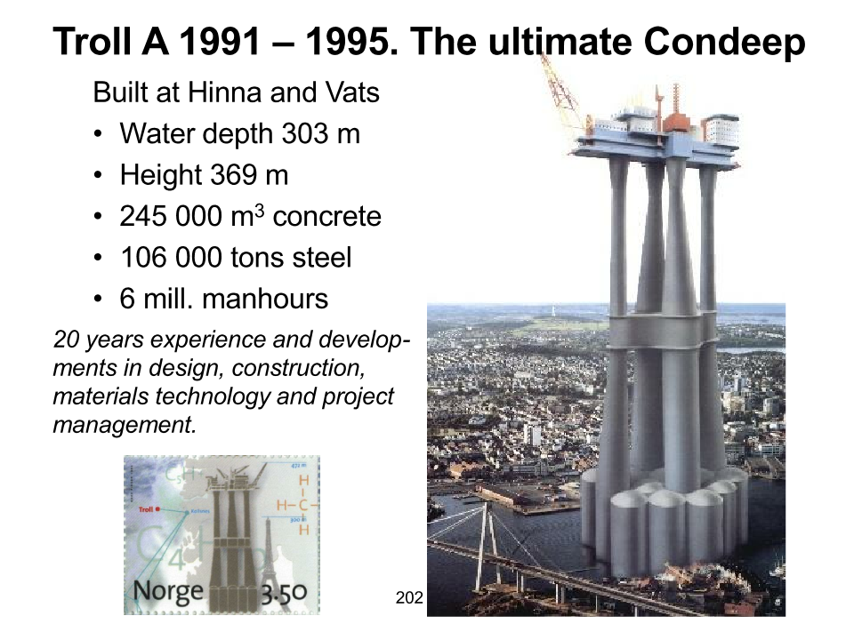
References
FeM - Silica is used in many important structures as the giant oil/gas platform Troll A in the North Sea where 5% FeM - Silica by weight of cement is used

Slide 23
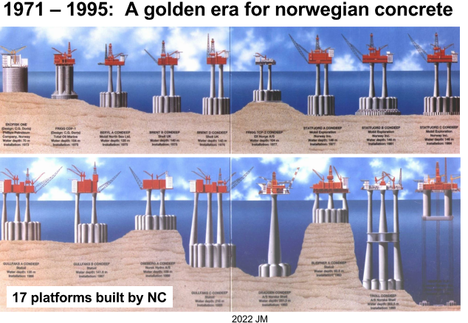

Slide 24


Here is a reliable topic of FeM-Silica
Confirming comman use in a broad spectre of concrete types
due to the beneficial effect on workability, mechanical strength, durability.
Norwegian road authority,now described that all new Norwegian Bridges
shall have a content between 3 – 10 % by the weight of cement
All SCC (self compacting concrete) made in Norway contain micro silica,
due to the good effect of holding aggregates in the fresh matrix,
scuring increased mechanical strength, durability, and less porosity.
Likewise, close to all concrete we use in Nye Veier AS contain FeM-Silica.
.

Slide 25
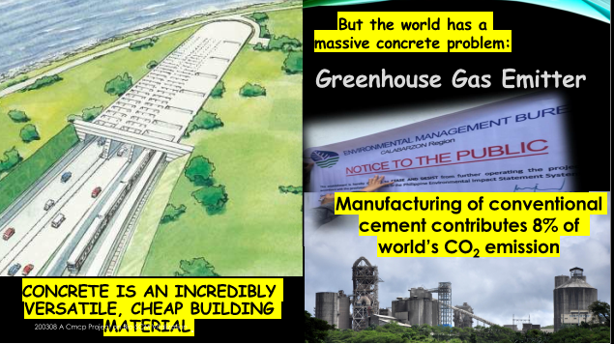
Even in Danmark, during my time as concrete engineer at ØTC
all tunnel concrete contain FeM-Silica

Slide 26
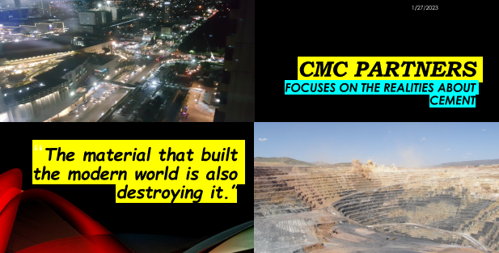
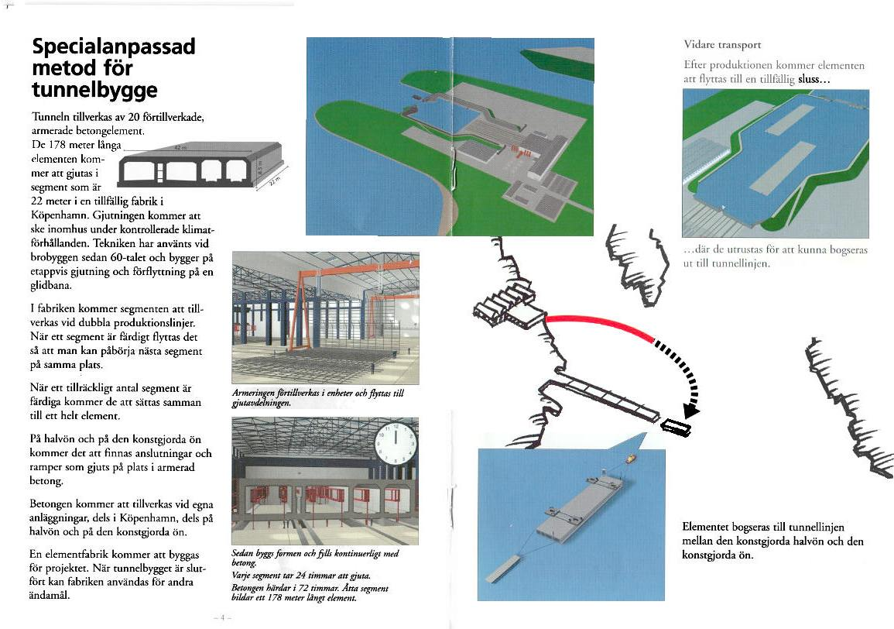

Slide 27

Tom Melbye | Senior Advisor Normet International Ltd.
Tom Melbye | Senior Advisor Normet International Ltd.
Rothusstrasse 21 | 6331 Hünenberg | Switzerlan| Mobile +41 79 449 8555
tom.melbye@normet.com | www.normet.com
References for use of FeM-silica in shotcrete ww for some big important projects
FeM-silica is widely used in most of the big tunnel and Under Ground projects world wide.
We estimate approx 12-14Mio m3/year in UG projects ww
40% of this is with use of m FeM-silica in the mixes .
Typical dosage is 5% of cement weight.
A few important projects ww added microsilica::
Gotthard railway tunnel in Switzerland -
- all shotcrete , normal concrete and tunnel segments
Crossrail UK and tunnel projects around London last 20 years
West and North Connex projects in Sydney ,Australia
Kiruna mine ,Sweden - 250.000 m3/year shotcrete added microsilica

Slide 28
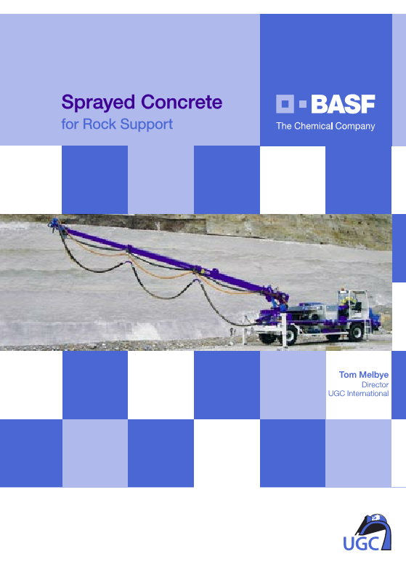
Further references for use of FeM-silica in shotcrete see in my sprayed concrete book pages 59,61,64,66,67,69,70,71,76,80,81 and 108.

Slide 29
BioM-silica means Sustainability
Magne Sollie - Norway
004790591594 / masolli@online.no
http://solliesolution.no
Sustainability is to secure today's needs
without destroying
the possibilities for future generations to have their needs met."
During the industrial revolution until today
most people's needs have increased in line with technical development
done by the current, old generation.
This mostly, by refining the resources in ways that
they become more accessible and beneficial to humanity.
This happened in overall communities
i.e. food, energy, building materials, quality of life etc.

Slide 30
Sorry to say, developments of today goes
  in the direction of exploiting the resources
    for personal and political gains
    with a short time horizon,
especially within Energy, Oil production and IT.
Everyone is pushed to buy the latest
  mobile phone and overpriced electricity and fuel.
  This to satisfy those people who do not stand for real sustainability,
  but use the “sustainability” to carry out their deeds.
Losers are "ordinary people", in lack of possibility and power to influence.

Slide 31
The “New Normal”, however, brought extensive changes in focus
  fighting a rising level of CO₂ in the atmosphere.
    the most important substance in agriculture, forestry and green growth.
The CO₂ now blamed for the overall climate change destroying the world
Production of Portland cement release huge amount of CO₂, emissions into the atmosphere
  during burning limestone together with quartz and slate,
      in large rotary kilns, at appox. 1450 degrees Celsius.
This process creates clinker granules
  which grounded together with gypsum (plaster) ends up as Portland cement.
Limestone is a mass of small petrified, compressed corals and molluscs
  that lived in the sea many millions of years ago.
The major part of limestone are carbon and oxygen,
  which when heavily heated pose the limestone into lime and CO₂. T
herefor the emissions from cement production come mainly from this calcination process (about 60%),
  the rest comes from the fuel heating the kilns and finally transportation out into the sites.

Slide 32
Producing ordinary Portland Cement releases
  approximately 1 tonne of CO₂ per tonne of clinker if no measures are taken.
    Around 40 % comes from fuel for burning, grinding etc and 60 % from decarbonisation of limestone to form clinker.
By replacing Portland Cement with Micro Silica / FeM- / BioM- Silica
  a significant decarbonation in concrete application/construction / final structures will be achieved.
In figures of concrete structures this Means;
  for every kg of BioM-silica we add, we reduce emissions by 5 kg of CO_{2 .}
In normal concrete that is
  70 kg CO_{2-emmision} /1 m³ and 7000 ton CO_{2-emmision} / 100,000 m³ ,
    all like 1,500 cars are CO₂₋ released per year

Slide 33

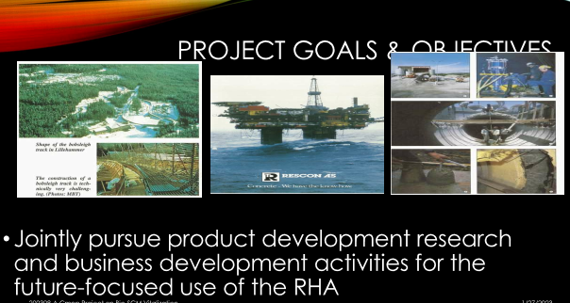

Slide 34
Philippine Cement- production
Roberto Caballero, Manila, Construction Materials Consultant
+63 969 181 8804 / rbrtcaballero@yahoo.com
https://www.linkedin.com/in/roberto-caballero-0a3b4b14
The estimated average commercial
  price ; PhP 240 per 40 kg bag >r @ PhP 6,000 per ton
    quantity; 40Mt (Mt - million tons).
      carbon footprint 0.5 ~ 0.6 per 1,000 tons / 20 ~ 24 Mt in the atmosphere.
With the expected rise in cement consumption
  due to the Build, Build, Build policy of the present administration
      the carbon foot prints will proportionally increases.
This is not in line with the COP27 conference late last year in Egypt.

Slide 35
FeM- /BioM- Silica - Use, Need and Benefits in the Philippines
All FeM-Silica used by the construction industry are imported.
  The price ; Php 800 per 20 kg bag / @ PhP 40,000 per ton
The extent of use in the construction industry is basically in
  high compressive strength and high durability concrete mixes.
    High rise buildings usually require very high compressive strength concrete mix designs.
FeM- Silica are also used during the construction of structure foundations especially where sulphate and chloride are present in the strata
Replacing 5 kg of cement / 1 kg / Ferro Micro Silica, results in
  a remarkable carbon footprints reduction in the concrete of structures.

Slide 36
BioM- Silica (mostly adjusted Rice Husk Ash ) appear as a
  biproduct, mostly treated and deposited as waste,
    by Bio power plants, feed / fueled with most, rice husk
Should also be used on offshore structures to
    enhanced durability of concrete against chloride attack.
Due to its extreme fineness FeM-Silica replacement
  prevents autogenous cracking
    produces very durable concrete structures
This adjusted ash, BioM - Silica has qualities
    that satisfy international standard as the similar
              FeM- Silica frequent used as additive/ replacer to cement in concrete structures worldwide.

Slide 37
Disposing of untreated BioM- silica becomes
  a serious environmental issue in the nearby community
    problems its use eliminates.
The European Norm for (ferro)micro silica
  does NOT cover Bio Micro Silica.
    I am the convenor for the silica fume committee...

Slide 38
BioM -Silica creates major benefits
    collected, bagged, labelled and marketed for use in concrete structures
    especially those in the Build, Build, Build initiative by the DPWH and DOTr.
    Its carbon footprints are greatly reduced, structures decarbonized.
The farmers are getting
  additional income, more motivated
    an overall activity enhancing food production and food security for the humanity community.
Likewise, marketing is an added revenue
    for the power plant and the host community.
It provid additional income
    generating employment for the marketing staff and connections.
All reasons and incentives mentioned
    the remarkable decarbonizing achieved,
      make it easy and very beneficial to invest in use of BioM – Silica

Slide 39
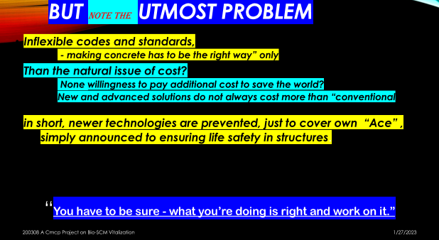
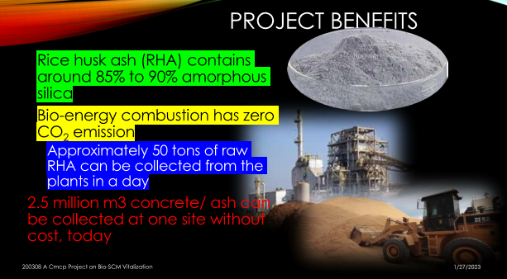

Slide 40
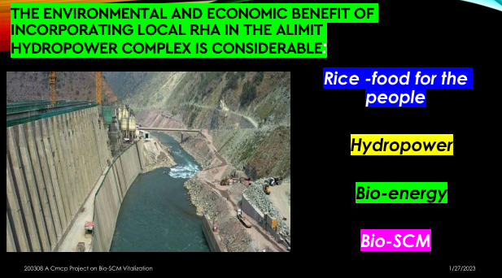
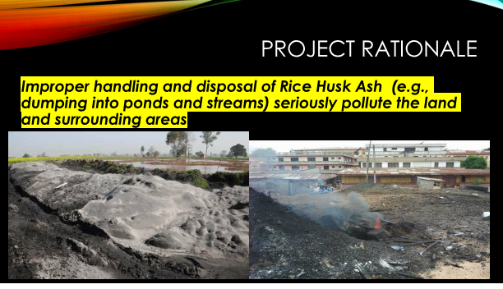

Slide 41
